Slide 1
SURVEY TECHNIQUES

Slide 2
Survey techniques
Techniques based upon the use of structured questionnaires given to a sample of a population.
Respondents may be asked a variety of questions regarding their behavior, intentions, attitudes, awareness, motivations, and demographic and lifestyle characteristics. These questions may be asked verbally, in writing or via a computer, and the responses may be obtained in any of these forms.
‘Structured’ here refers to the degree of standardization imposed on the data collection process. In structured data collection, a formal questionnaire is prepared and the questions are asked in a prearranged order.

Slide 3
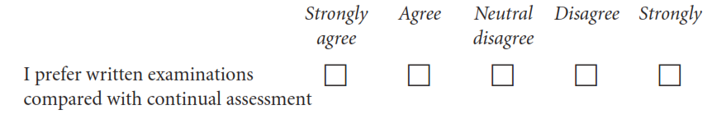
In a typical questionnaire, most questions are fixed-response alternative questions that require the respondent to select from a predetermined set of responses.
Consider, for example, the following question, designed to measure a dimension of students’ attitudes towards the way they are assessed in marketing research classes:

Slide 4
Survey questionnaires may be administered in four major modes:
Telephone interviews,
Personal interviews,
Mail interviews
Electronic interviews
Telephone interviews may be further classified as traditional telephone interviews and computer-assisted telephone interviews (CATIs).
Personal interviews may be conducted in the home or office, as street interviews, or as computer-assisted personal interviews (CAPIs).
Mail interviews, takes the form of traditional mail surveys, or surveys conducted using mail panels.
Electronic interviews can be conducted via email or administered on the Internet.

Slide 5
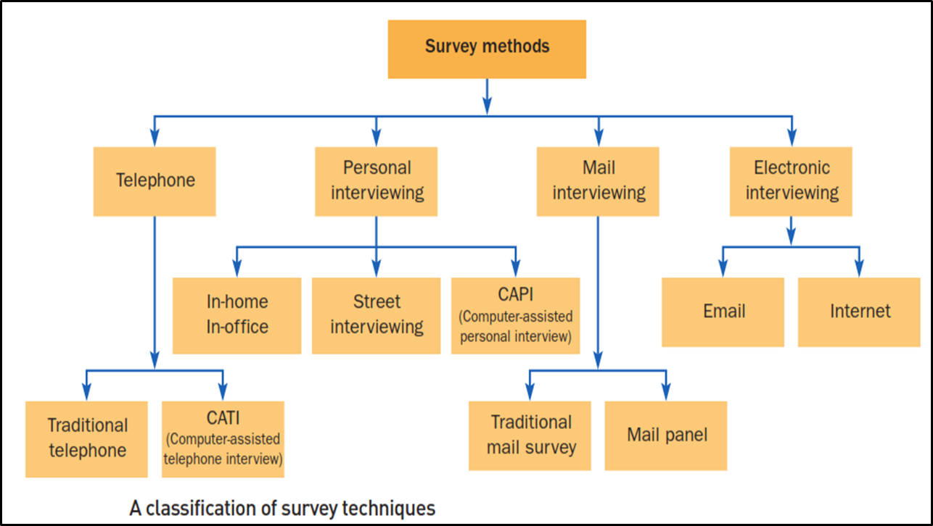
Important

Slide 6
Traditional telephone interviews
Traditional telephone interviews involve phoning a sample of respondents and asking them a series of questions. The interviewer uses a paper questionnaire and records the responses with a pencil.
These interviews tend to be short in duration and have questions with few options as answers. Today, this approach is rarely used in commercial marketing research, the common approach being CATI.

Slide 7

Computer-assisted telephone interviews (CATI)
CATI uses a computerized questionnaire administered to respondents over the telephone. A computerized questionnaire may be administered using a networked computer or a PC. The interviewer sits in front of a terminal and wears a small headset. The terminal replaces a paper and pencil questionnaire, and the headset substitutes for a telephone.
Upon command, the computer dials the telephone number to be called. When contact is made, the interviewer reads questions posed on the screen and records the respondent’s answers directly into the computer memory, ready for immediate analysis.

Slide 8
Personal in-home and in-office interviews
In personal in-home interviews, respondents are interviewed face to face in their homes or in their workplace. The interviewer’s task is to contact the respondents, ask the questions and record the responses.
In recent years, the use of personal in-home interviews has declined due to their high cost. There are many situations where they are used because of the reassurances of quality of the interview process and the nature of the questions that are being administered.

Slide 9
Street interviews
In street interviews, respondents are intercepted while they are shopping in town centers or shopping centers.

Slide 10
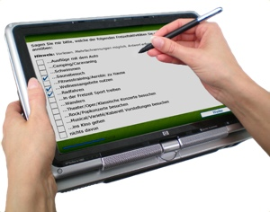
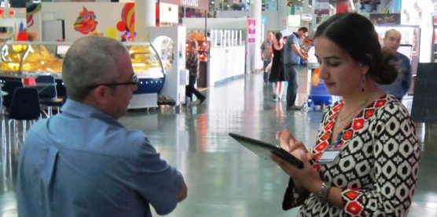
Computer-assisted personal interviews (CAPI)
In CAPI, the third form of personal interviewing, the respondent sits in front of a computer terminal and answers a questionnaire on the screen by using the keyboard or a mouse.
There are several user-friendly electronic packages that design relatively simple questions for the respondent to understand. Help screens and courteous error messages are also provided. The colorful screens and on- and off-screen stimuli can all contribute to making the interview process interesting and stimulating. This method has been classified as a personal interview technique because an interviewer is usually present to serve as a host or hostess and to guide the respondent as needed.

Slide 11
Traditional mail surveys
In the traditional mail survey, questionnaires are mailed to preselected potential respondents. A typical mail survey package consists of the outgoing envelope, cover letter, questionnaire, return envelope and possibly an incentive.
The respondents complete and return the questionnaires. There is no verbal interaction between the researcher and the respondent in the survey process.
There may be an initial contact with potential respondents, to establish who is the correct person to send the questionnaire to, and to motivate them before they receive the survey.

Slide 12
Mail panels
A mail panel consists of a large, nationally representative sample of households that have agreed to participate in periodic mail questionnaires and product tests.
A pre-recruited panel that is willing to participate makes it easier to set up a product test and conduct interviews after the test. Panels are made up of a ‘pool’ of individuals or households who have agreed to be available for surveys of widely varying types and topics. The households are compensated with various incentives.
Mail panels can be used to obtain information from the same respondents repeatedly. Thus, they can be used to implement a longitudinal design.

Slide 13
Sugging
The use of marketing research to deliberately disguise a sales effort.
Frugging
The use of marketing research to deliberately disguise fundraising activities.

Slide 14
THANK YOU

Slide 15
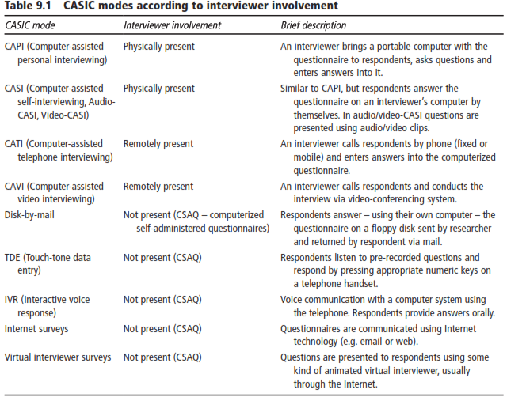
Fielding, Nigel - The Sage handbook of online research methods, 2e (2017)

